Slide 1

<CUSTOMER BILLING SYSTEM>
SRM INSTITUTE OF SCIENCE AND TECHNOLOGY
FACULTY OF ENGINEERING AND TECHNOLOGY
DEPARTMENT OF NETWORKING AND COMMUNICATIONS
18CSC101J- MINI PROJECT
DONE BY:
JAGADEESH P(112)
KARTHICK RAJA(116)
DHEERAJ G (113)
BRANCH: CSE w/s AIML
SECTION: T1
FACULTY NAME:SINDHUJA MA’AM

Slide 2
Table of contents
Introduction
Objectives
Algorithm
Flowchart
Modules
Results and Discussions
Snapshots of the result
Sample Coding

Slide 3
Costumer Billing System INTRODUCTION:
Customer Billing System Project is a simple console application designed to demonstrate the practical use of C programming language and its features as wells as to generate an application which can be used in any departmental store, shops, cafes etc. for billing to the customer.
You can use this application to keep the records such as name, address, mobile number, paid amount, due amount, payment date etc. of your regular costumer. Moreover, if you have a new customer, you can add and edit the account at any time.

Slide 4
OBJECTIVES
The main objectives of this project are listed as follows:
➢ Proper management of customer billing system.
➢ Add and maintain customer detail.
➢ Can be useful for both manager and cashier. ➢ Maximum providence of search options.
➢ User friendly messages in the way for easy application of program.

Slide 5
ALGORITHM
Step 1 : Start
Step 2 : Display Main Menu as given below:
1. To Add Account on list
2. To Search Customer’s Account
3. Exit
Step 3 : Get the input choice from the user
Choice 1 - Call the function to add account on list
Choice 2 - Call the function to search customer’s account
Choice 3 - Call the function to exit the system
Step 4 : Output Generated is the text file
Step 5 : End

Slide 6
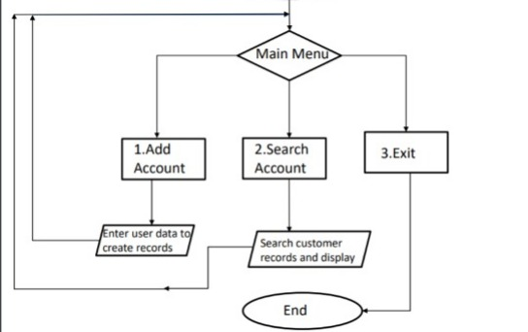
FLOWCHART
Start

Slide 7
MODULES
We will use 3 modules in this project. These are as follows:
Module 1: To add account
It can hold any number of accounts and account can be added to the program at any time.
The programming of simple calculations such as calculation of due amount, balance etc. have been embed in the code of project.
Module 2: To search account
The Customer Billing System project in C gives you the facility of searching the account by two ways, either by name of the customer or by the number of customer.
The due amount to be paid is shown as negative balance.
Module 3: To exit
If you have nothing to do with the program, you can directly exit from the main menu.

Slide 8
RESULTS AND DISCUSSIONS
We have been able to design a Customer Billing System using C language. This system has features such as :
1.You can hold any number of accounts and account can be added to the program at any time.
2.The programming of simple calculations such as calculation of due amount, balance etc. have been embed in the code of project.
3.The due amount to be paid is shown as negative balance.
4.If you have nothing to do with the program, you can directly exit from the main menu.

Slide 9
TOOLS USED
GCC Compiler
GNU/GDB debugger
Lucid chart
Gedit

Slide 10
WORKING OF YOUR SYSTEM
Hardware requirements :
Hard disk : 1 TB or 512 SSD
Processor : intel core i5
RAM : 512 MB or more than 512 MB
Compact Drive
Printer

Slide 11
Software Requirements :
Operating system : windows 10
Turbo c++ ,for execution of program
MS word for presentation of output
Language used : C

Slide 12
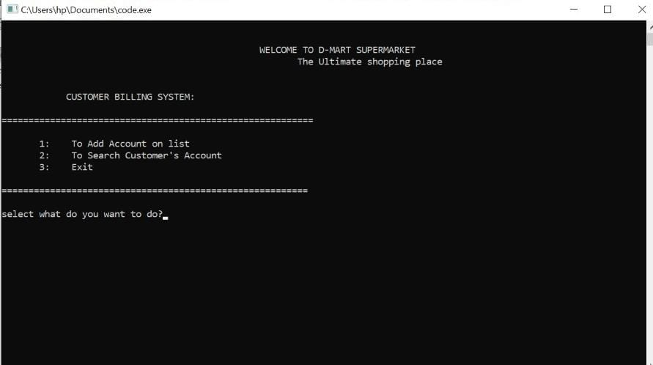
SNAPSHOTS OF THE RESULT

Slide 13
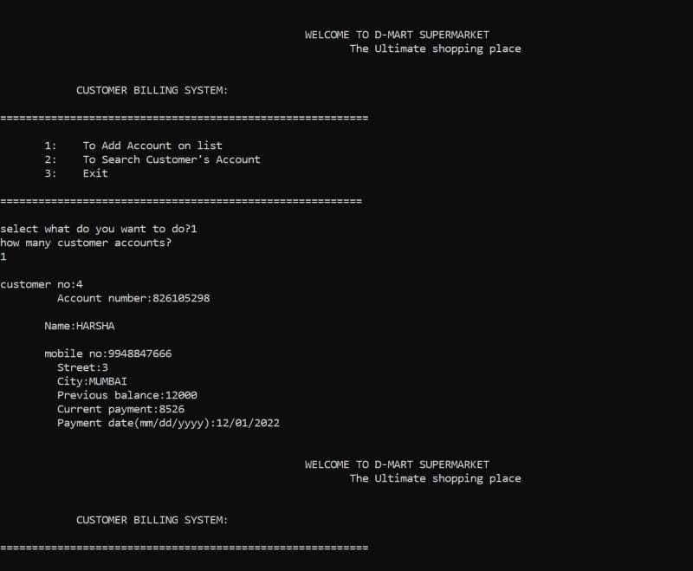
OUTPUT FOR CHOICE 1:

Slide 14
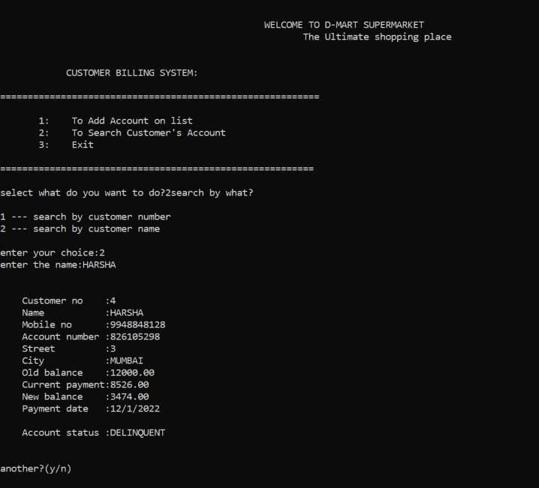
OUTPUT FOR CHOICE 2:

Slide 15
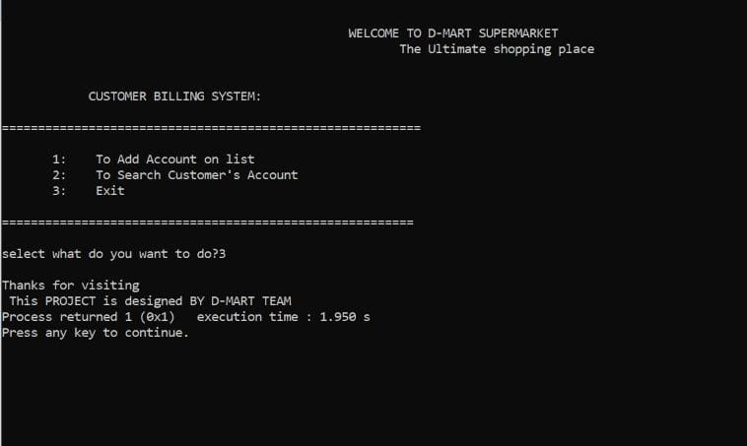
OUTPUT FOR CHOICE 3:

Slide 16
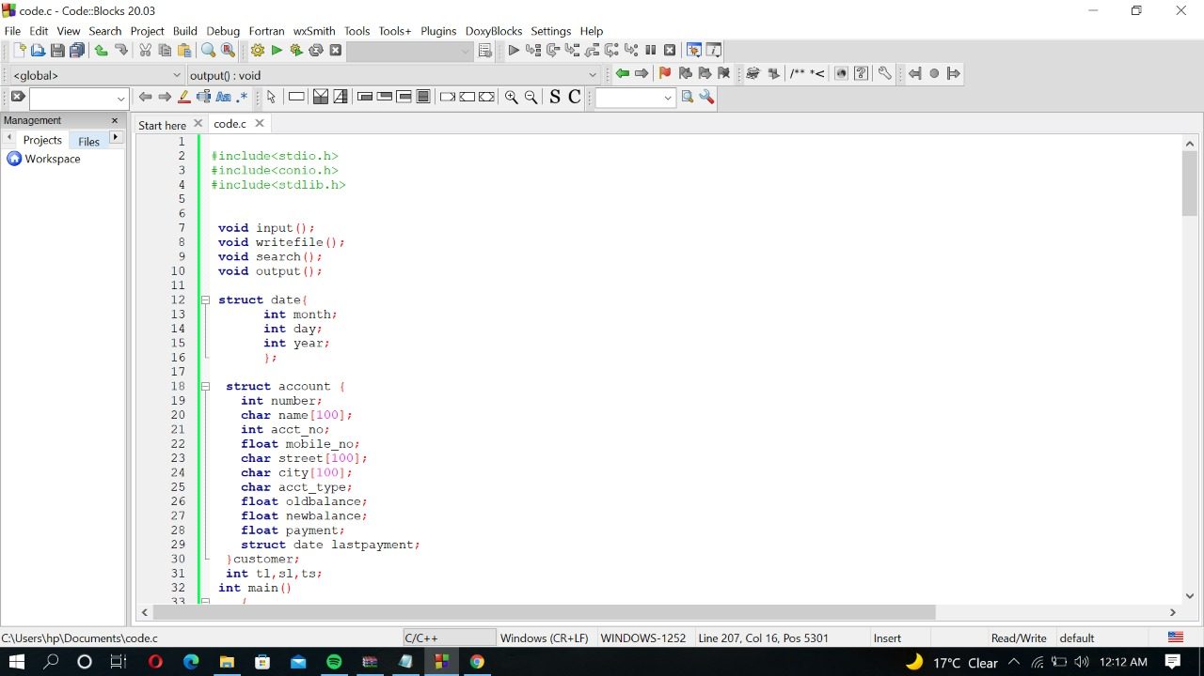
SAMPLE CODING

Slide 17
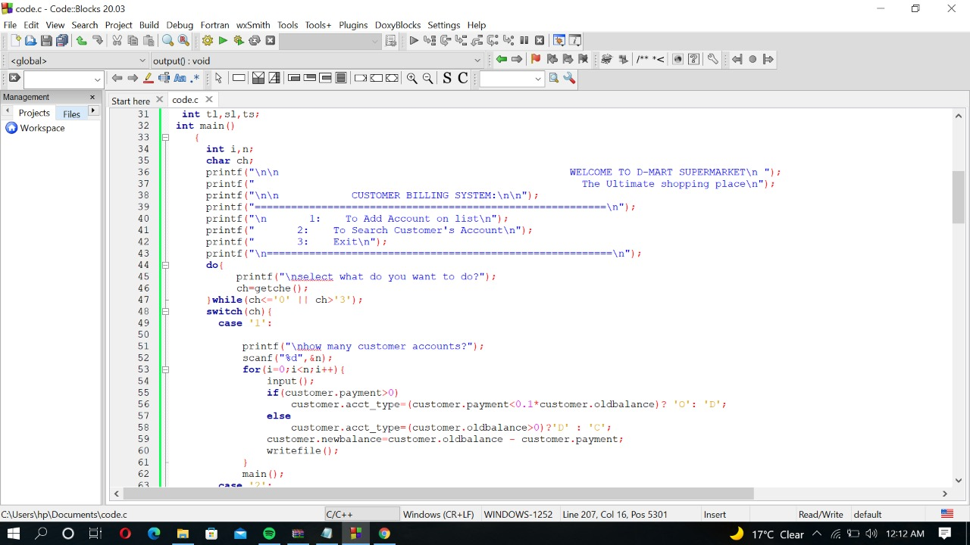

Slide 18
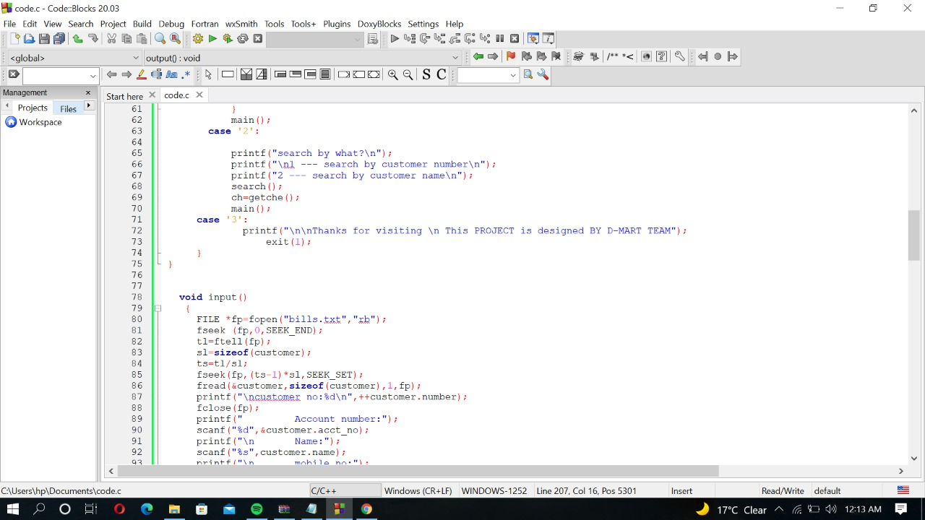

Slide 19
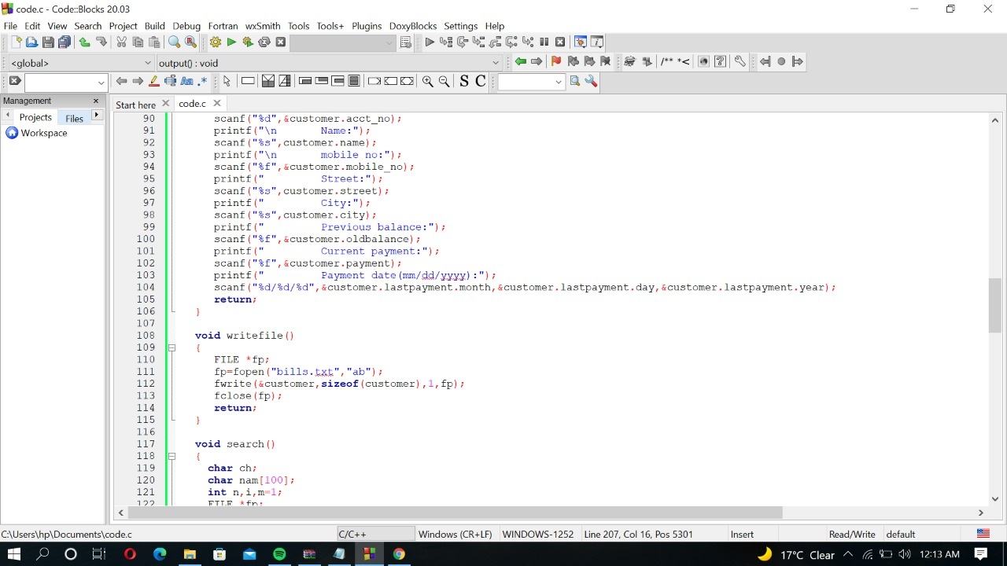

Slide 20
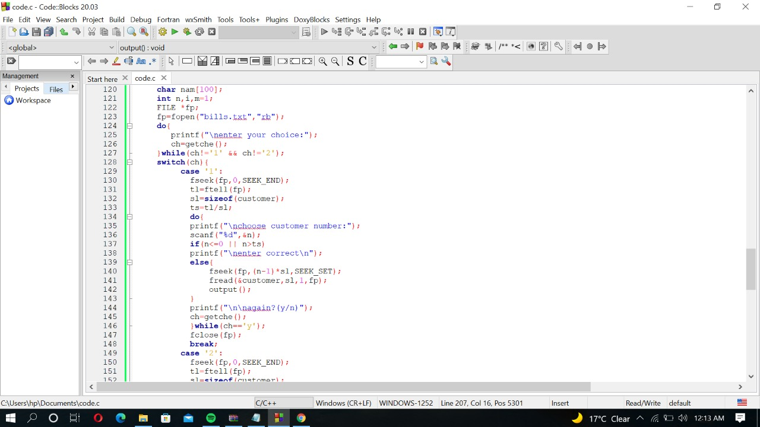

Slide 21
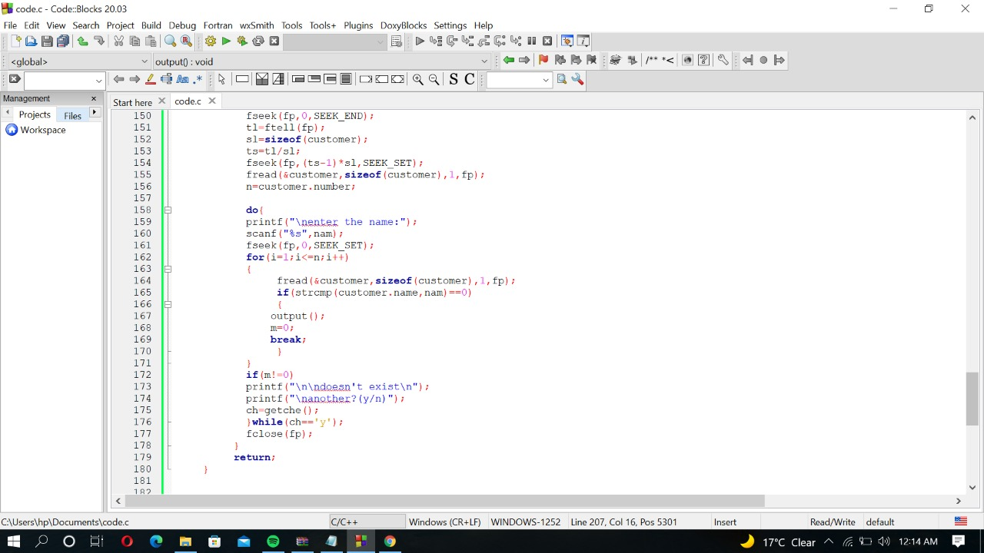

Slide 22
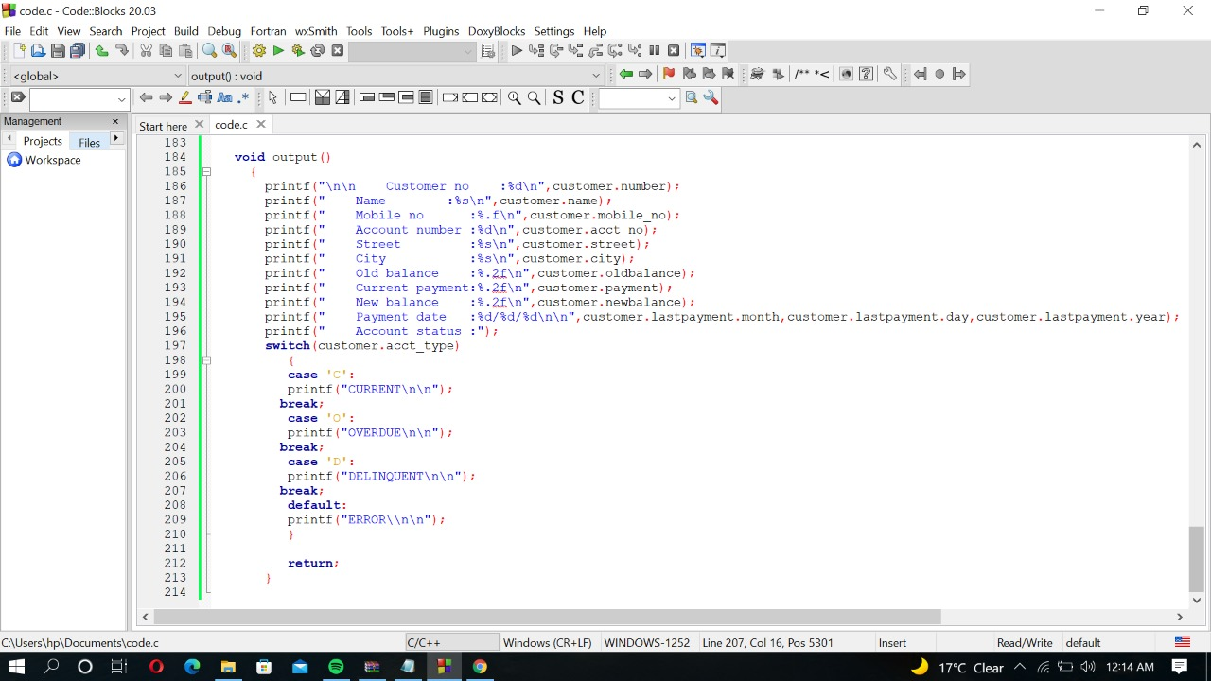

Slide 23
CONCLUSION
Our project and implementation is on Customer Billing System. We have successfully completed it. We take this opportunity to express our sense of indebtedness and gratitude to all those people who helped us in completing this project and implementation.

Slide 24
THANKS

